Slide 1
Presentation on DES Advantage & Attack
Presented to : Presented By:
Falguni Roy Sultana Marjan (BKH1925010F)
Assistant Professor, Sourav Barman (ASH192530M)
IIT,NSTU

Slide 2
Content:
DES
Advantage of DES
Attack on DES

Slide 3
Basic of DES
Algorithm
Permutation
Expansion
Contraction
XOR
Left Circular Shift
Substitution S-Box
Key Schedule
Encryption Process
10.Decryption Process

Slide 4
What is DES ?
The DES (Data Encryption Standard) algorithm is a symmetric key block cipher created in the early 1920s by an IBM team and adopted by the National Institute of Standards and Technology (NIST).

Slide 5
Features of DES
DES is a Feistel Cipher
It is most widely used block cipher in world
Adopted in 1977 by National Bureau Standards (NBS)
64-bit block length
56-bit key length
48 bits of key used in each round
Each round is simple (for a block cipher) security depends primarily on “S-Boxes”.
Each S-Boxes maps 6 bits to 4 bits

Slide 6
The DES Algorithm
The main parts of the algorithm are as follows:
Fractioning of the text into 64-bit (8 octet) blocks
Initial permutation of blocks
Breakdown of the blocks into two parts: Left and Right, named LPT (Left Plain Text) and RPT (Right Plain Text)
Permutation and Substitution steps repeated 16 times (called rounds)
Re-joining of the left and right parts then inverse initial permutation

Slide 7
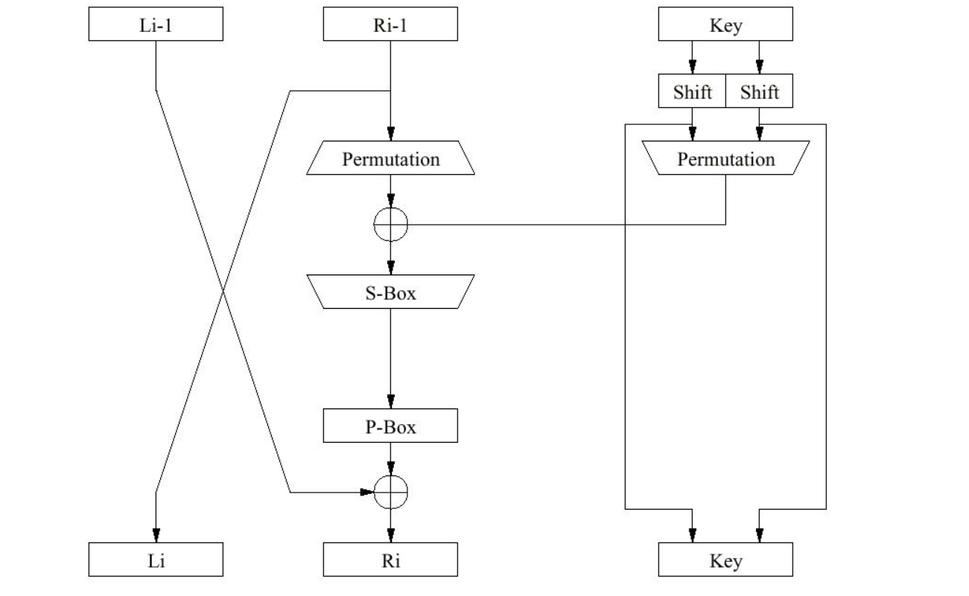
DES Encryption

Slide 8
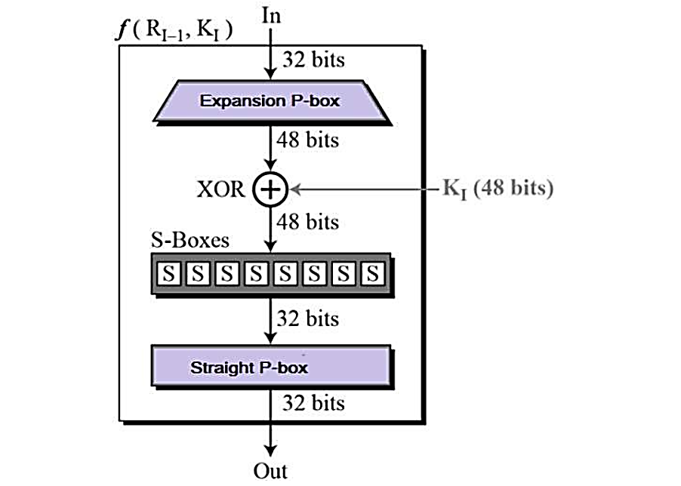

Slide 9
Rounds in Data Encryption Standard
Now, we will discuss the process that takes place during 16 rounds of DES algorithm. Each round of DES performed the same function. So, below are the steps of the function performed in each round of DES algorithm.

Slide 10
1. Key Transformation
2. Expansion Permutation
3. S-Box Substitution
4. P-Box Substitution
5. X-OR and Swap

Slide 11
1.Key Transformation
Earlier, we have discussed that the initial key size is 64-bit which is reduced to the 56-bit key. This is done by discarding every 8th bit from the 64-bit key. So, for each round of DES, this 56-bit key is used. In the key transformation step, this 56-bit is transformed to the 48-bit key. Let’s see how?

Slide 12
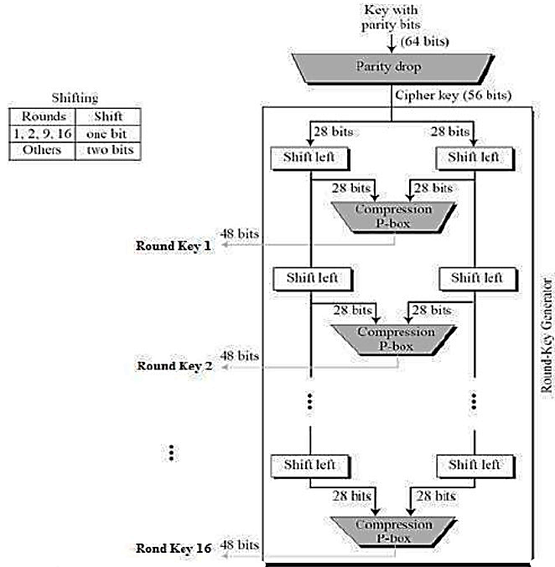
Key Transformation

Slide 13
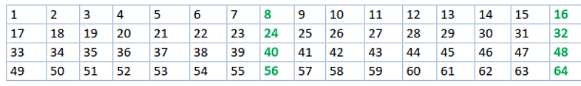
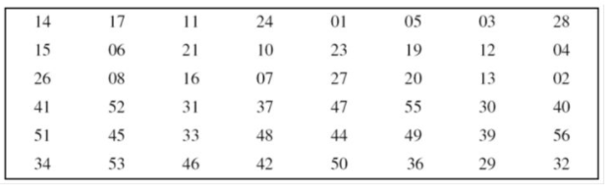
Discarding 8th Bit
Compression Permutation

Slide 14
2.Expansion Permutation
In the first step of encryption, during the initial permutation of DES, the 64-bit plain text is permuted and we have 32-bit LPT and 32-bit RPT. Now the expansion permutation is performed on the 32-bit RPT which transforms it from 32-bit to 48-bit.

Slide 15
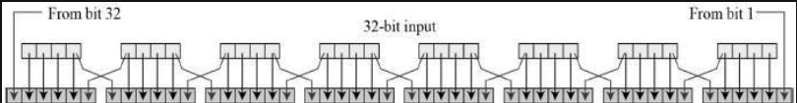
After expansion, now the 48-bit RPT is XORed with the 48-bit key and the resultant 48-bit block is transformed to S-Box substitution.

Slide 16
3.S-Box Substitution
The input to S-Box is the resultant block of Expansion Permutation. In S-Box substitution, the input 48-bit block is transformed to 32-bit block. Let’s see how?

Slide 17
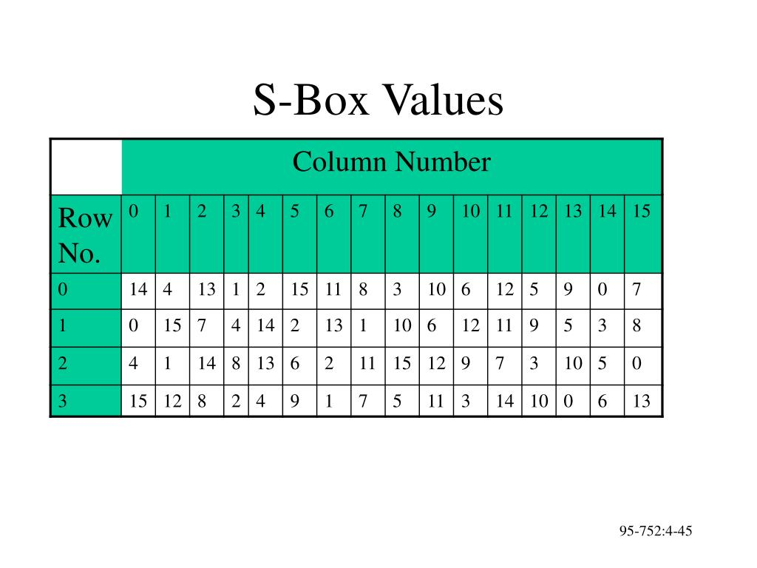

Slide 18
input 101110
10
 | 0000 | 0001 | 0010 | 0011 | 0100 | 0101 | 0110 | 0111 | 1000 | 1001 | 1010 | 1011 | 1100 | 1101 | 1110 | 1111
00 | 14 | 4 | 13 | 1 | 2 | 16 | 11 | 8 | 3 | 10 | 8 | 12 | 6 | 0 | 0 | 7
01 | 0 | 15 | 7 | 4 | 14 | 2 | 13 | 1 | 10 | 0 | 12 | 11 | 8 | 5 | 3 | 8
10 | 4 | 1 | 7 | 8 | 13 | 0 | 2 | 11 | 16 | 12 | 9 | 7 | 3 | 10 | 6 | 0
11 | 16 | 12 | 10 | 2 | 4 | 0 | 1 | 7 | 6 | 11 | 3 | 14 | 10 | 0 | 5 | 13
Box S1
Output 11 in binario = 1011

Slide 19
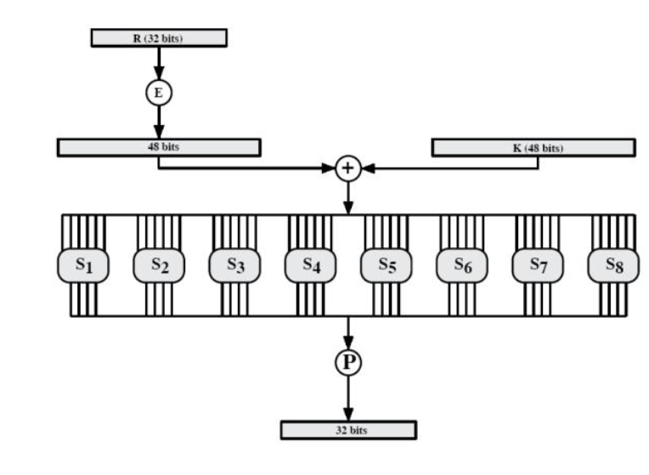

Slide 20
4.P-Box Permutation
The 32-bit output obtained from S-Box substitution is provided as an input to P-Box. Here, the 32-bit input is simply permuted and send to the next step.

Slide 21
5.XOR and Swap
As, we can observe so far, we have been operating on the 32-bit RPT of the initial 64-bit plaintext. The 32-bit LPT is still untouched. In this step, the 32-bit LPT of the initial 64-bit plaintext is X-OR with output of P-Box permutation.
The result of the X-OR is the new RPT for next round and the old RPT is swapped with LPT. So, the old RPT is now new LPT for next round. The old RPT is now new LPT for next round.

Slide 22
So, here the process of a single round ends and next round start which has the same function.
After 16 such rounds, the output of the 16th round undergoes final permutation. The result of this final premutation is 64-bit ciphertext.

Slide 23
DES Decryption
The same Data Encryption Standard algorithm used for encrypting the plain text is also used to decrypting the ciphertext. But the algorithm is reversed, such as the initial and the final permutation events are reversed. Even the sequence of the subkeys applied in 16 rounds of DES are also reversed.

Slide 24
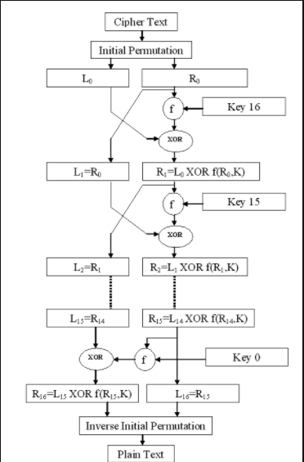
DES Decryption

Slide 25
Advantages of DES
1. DES has been around a long time (since 1977), even now no real weaknesses have been found: the most efficient attack is still brute force. 2. DES is an official United States Government standard; the Government is required to re-certify, DES every five years and ask it be replaced if necessary. DES has been re-certified in 1983, 1987, 1992. 3. DES is also an ANSI and ISO standard - anybody can learn the details and implement it. 4. Since DES was designed to run on 1977 hardware, it is fast in hardware and relatively fast in software.

Slide 26
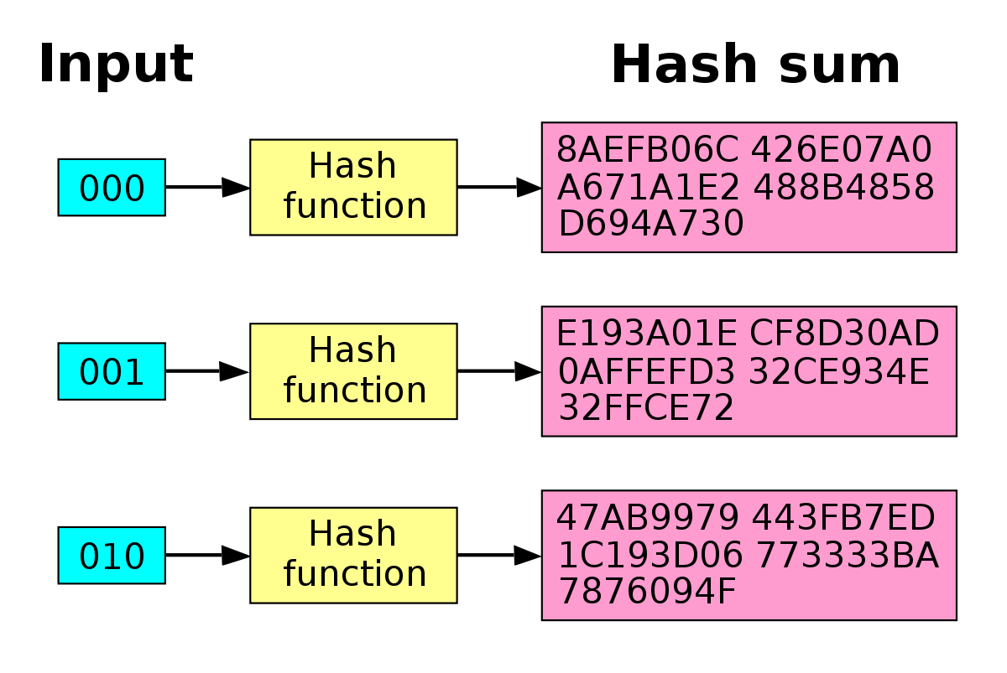
Avalanche Effect in DES
A desirable property of any encryption algorithm is that a small change in either the plaintext or the key should produce a significant change in the ciphertext.
In particular, a change in one bit of the plaintext or one bit of the key should produce a change in many bits of the ciphertext.
This is referred to as the avalanche effect. If the change were small, this might provide a way to reduce the size of the plaintext or key space to be searched.

Slide 27
Major cryptanalytic attacks against DES
1976: For a very small class of weak keys, DES can be broken with complexity 1
1977: Exhaustive search will become possible within 20 years, breaking DES with complexity 256
1980: A time/memory tradeoff can break DES faster at the expense of more memory
1982: For a very small class of semi-weak keys, DES can be broken with complexity 1
1985: A meet-in-the-middle attack can break 6-round DES with complexity 252
1987: the “Davies Attack” can break DES with complexity 256.2 ,slightly worse than brute force
1990: Differential cryptanalysis can break DES with 247 chosen plaintext (full 16-round) 1993: Linear cryptanalysis can break DES with 243 known plaintexts
1994: Differential-linear cryptanalysis can break 8-round DES with 768 chosen plaintexts plus 246 a brute-force search
1994: the Davies attack can be improved, and can break DES with 252 known plaintexts

Slide 28
Attacks on DES
Davies attack.
Timing attack.
statistical attacks.
(a) Differential cryptanalysis.
(b) Linear cryptanalysis.
(c) Related key attack.

Slide 29
Davices attack
Davies attack is a specialized technique for DES,first suggested by Donald davies in the eighties.
The most powerful form of the attack requires 2^50 known plaintexts has a computational complexity of 2^50 and has a 51% success rate.

Slide 30
Timing attack
A timing attack is one in which information about the key or plaintext is obtained by observing how long it takes a given implementation to perform decryptions on various ciphertexts.
10 seconds
Ciphertext 1
System 1
Plaintext 1
Ciphertext 2
System 1
Plaintext 2
5 seconds

Slide 31
Differential cryptanalysis
Differential cryptanalysis was rediscovered in the late 1980s by Eli Biham and Adi shamir.It was known earlier to both IBM and tha NSA and kept secret.
Powerful method to analyse block ciphers .
To break the full 16 rounds,differential cryptanalysis requires 2^47 chosen plaintexts.
DES was designed to be resistant to Differential cryptanalysis.

Slide 32
Linear cryptanalysis
Another recent development .
Also a statistical method .
Based on finding linear approximations to model the transformation of DES
Can attack DES with 2⁴³ known plaintexts, still in practise infeasible

Slide 33
Thank you

